Slide 1





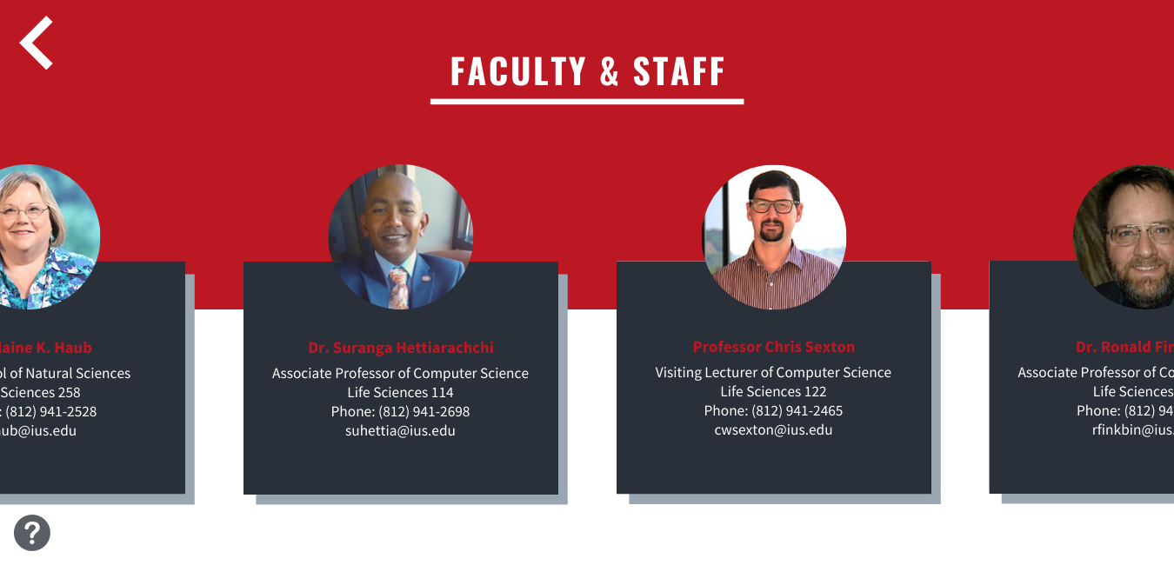
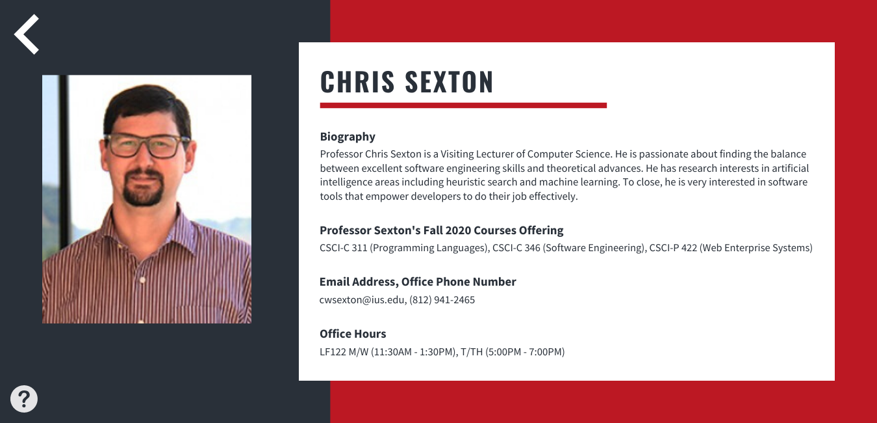
Natural Science Interactive Displays
Amanda Goodridge, Brandon Baugh, Will Schottler
Indiana University Southeast
Faculty Sponsor: Dr. Finkbine
School of Natural Science, Indiana University Southeast, New Albany, IN
Abstract
Tasked with creating a budget and building new touch screen walls for the Life Science and Physical Science buildings. The budget was made and proposed. The building will have to wait till the budget is approved, in the meantime planning has been done and completed with the proposed design for the touch screen walls and their function. There have been interactive projectors that were added to the plan as well by the customer. These are taken into account in the planning of the project.
Software Vision
Hardware Vision
Methodology
This project was sponsored by the Dean of Natural Science, Dr. Elaine K. Haub, and her Administrative Assistant, Dana Hope. The first semester, we created a budget for two large interactive displays. One display would be placed in the entrance of the Life Science building and the other in the entrance of the Physical Science building. After creating a budget, we created software designs and prototypes showing what the software would look like. We discussed the hardware requirements of the project and met with UITS to discuss the feasibility of this project being implemented in one academic year.
Implementation and Future Work
This project ended up being a detailed analysis of a future system that will be implemented on Indiana University Southeast’s campus in the Life Science and Physical Science buildings. Unfortunately, after several attempts to get a budget approved, time ran out and we were not able to get the large budget we needed approved. Therefore, the implementation aspect of the project wasn’t feasible for us. This meant that for us, we were essentially creating an implementation report for a future capstone group. We created a budget plan detailing both software and hardware expenses, wrote several documents explaining the requirements gathered from the Dean and Dana Hope, and even designed software showing what the final interactive system would look like.
Therefore, the future work for this project would be to physically implement the system. This shouldn’t be too difficult because our capstone group has already completed the documentation, system requirements, and budget. To conclude, all that is left for this project is to purchase the items on the budget analysis and design software to reflect the designs we created.
Budget Plan
The budget for this project was at first not given. They told us to find prices for different designs and styles of touch walls. The first set of design ideas had the lowest at $60,000. At seeing this we were asked if we could come up with cheaper ideas. We came back with three other ideas with the max at $8,500. We mentioned that none of these were quite what they had originally asked for, but they could work. It was after this that the client started the process of procurement of funds.
References
Dalvet, Gabrielle. “The Best Large Touch Screen Monitors for Today's Offices.” Robin, 30 Sept. 2019, www.robinpowered.com/blog/best-large-touch-screen-monitors/.
Miranda, Mark. “Everything You Want to Know About A Touch Video Wall.” Digital Touch Systems, 22 Nov. 2019, www.digitaltouchsystems.com/everything-want-know-touch-video-wall/.

